Slide 1
QuPath (pos)cell counting optimization guide
Version 0.3, 29-07-2025
By Arian Mohammadi
Parameter recommendations are for BF microscopy with 400x magnification
Works with any tissue

Slide 2
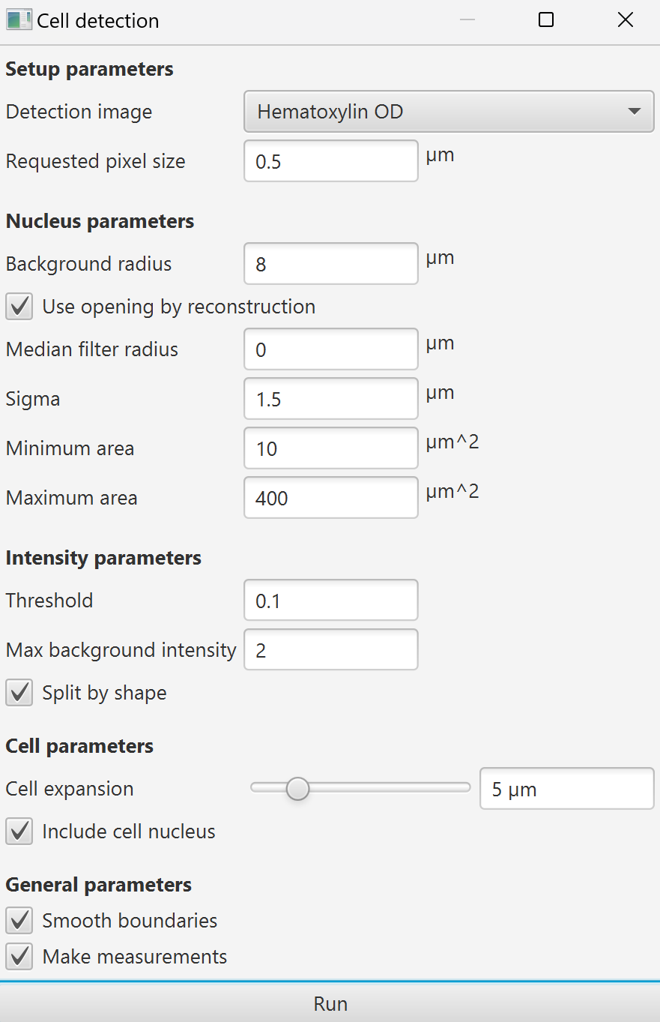
Overall explanation
Starting QuPath‘s cell detection, you will be met with the seetings, seen in the picture on the right. There are some settings/parameters/staining vectors you might want to change before starting your cell detection.
By the Way: Your settings won’t be saved. Create a script when you find optimal values.

Slide 3
Pixel size:
Desc:
Basically, the quality of the input image. Changes the sample size of the cell detection plugin.
The lower the higher the quality, but the processing will need more ressources and time.
In my experience, it didnt make any significant difference regarding the cell count (0.5-1 percent), but I set it to 0.3 just to be that extra bit more sure. For faster processing times this could be set to 1.
Best value for my images: 0.3
Optimization range:
0.1-1 µm in 0.1 intervals.

Slide 4
Background radius:
Desc:
Takes out background in relation to a circle's radius to subtract the background and keep the nuclei for the cell count. If there are clusters to be seen, a bigger number is better. I chose 30 since it worked for me the best.
This video helps with understanding this concept: 7 - Thresholds and background
Best value for my images: 30
Optimization range:
0 µm or 8 – 50 in 2µm intervals.
It should basically be set to the radius of the biggest cluster you have, or removed completely to adjust the parameters with the threshold.

Slide 5
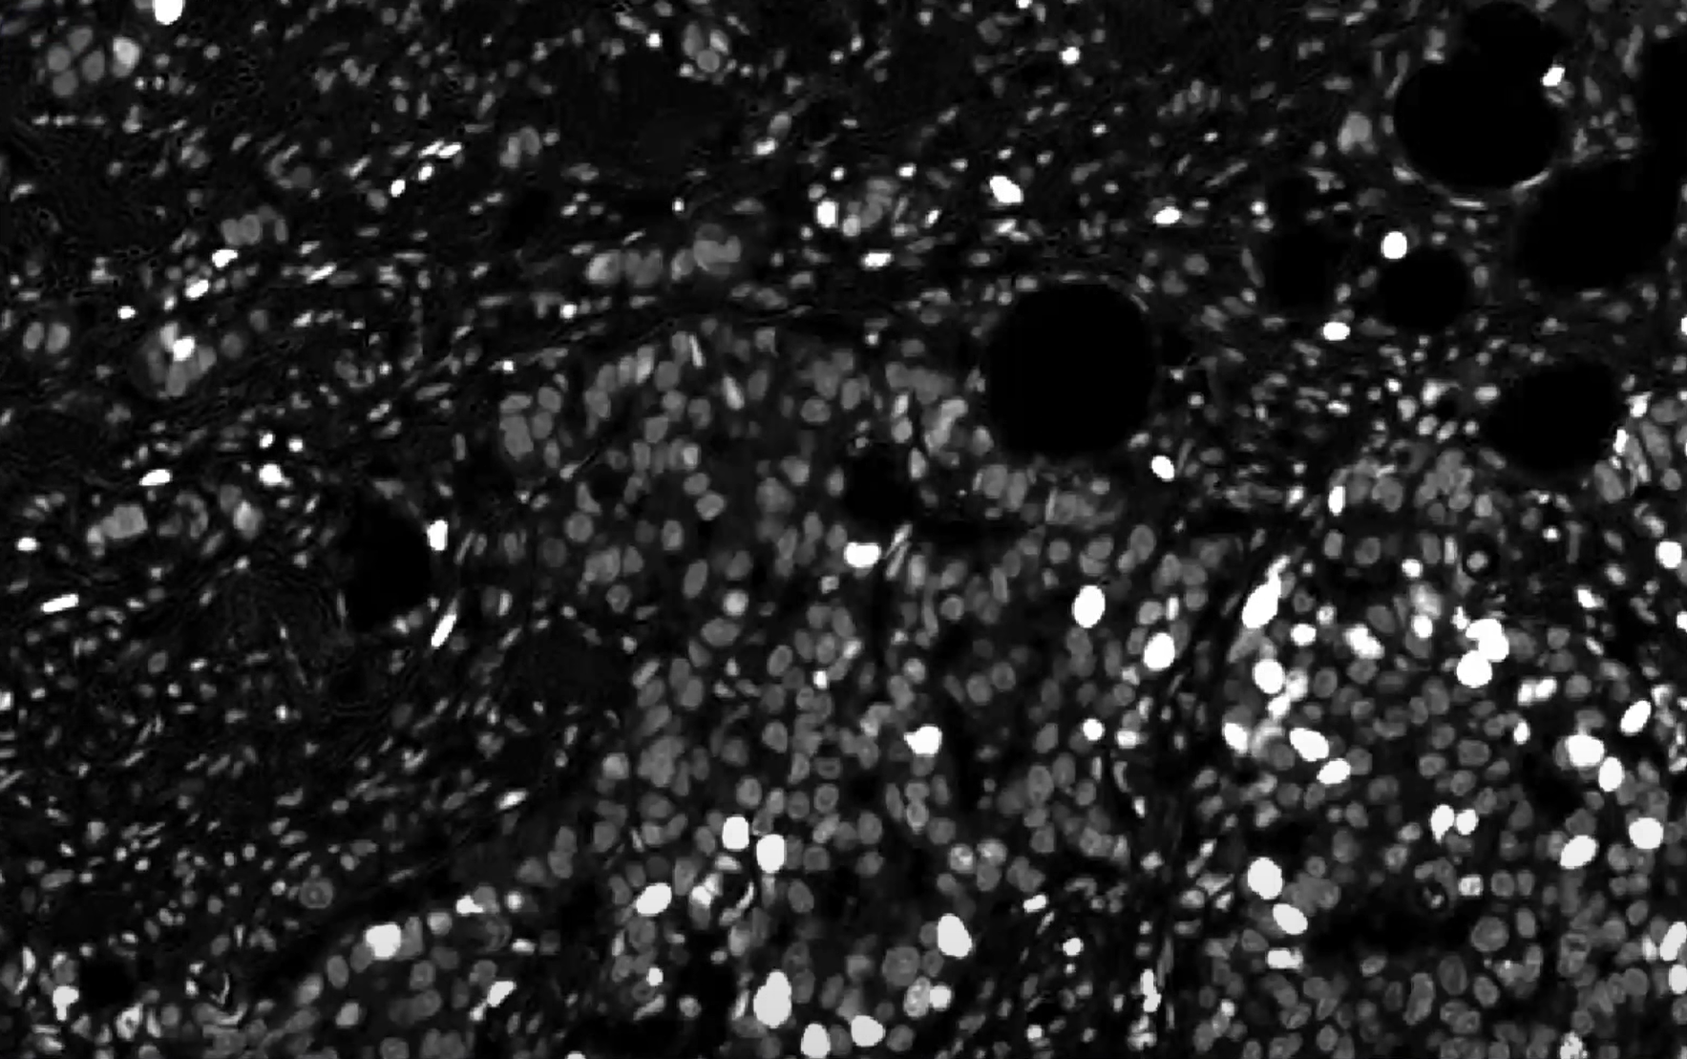
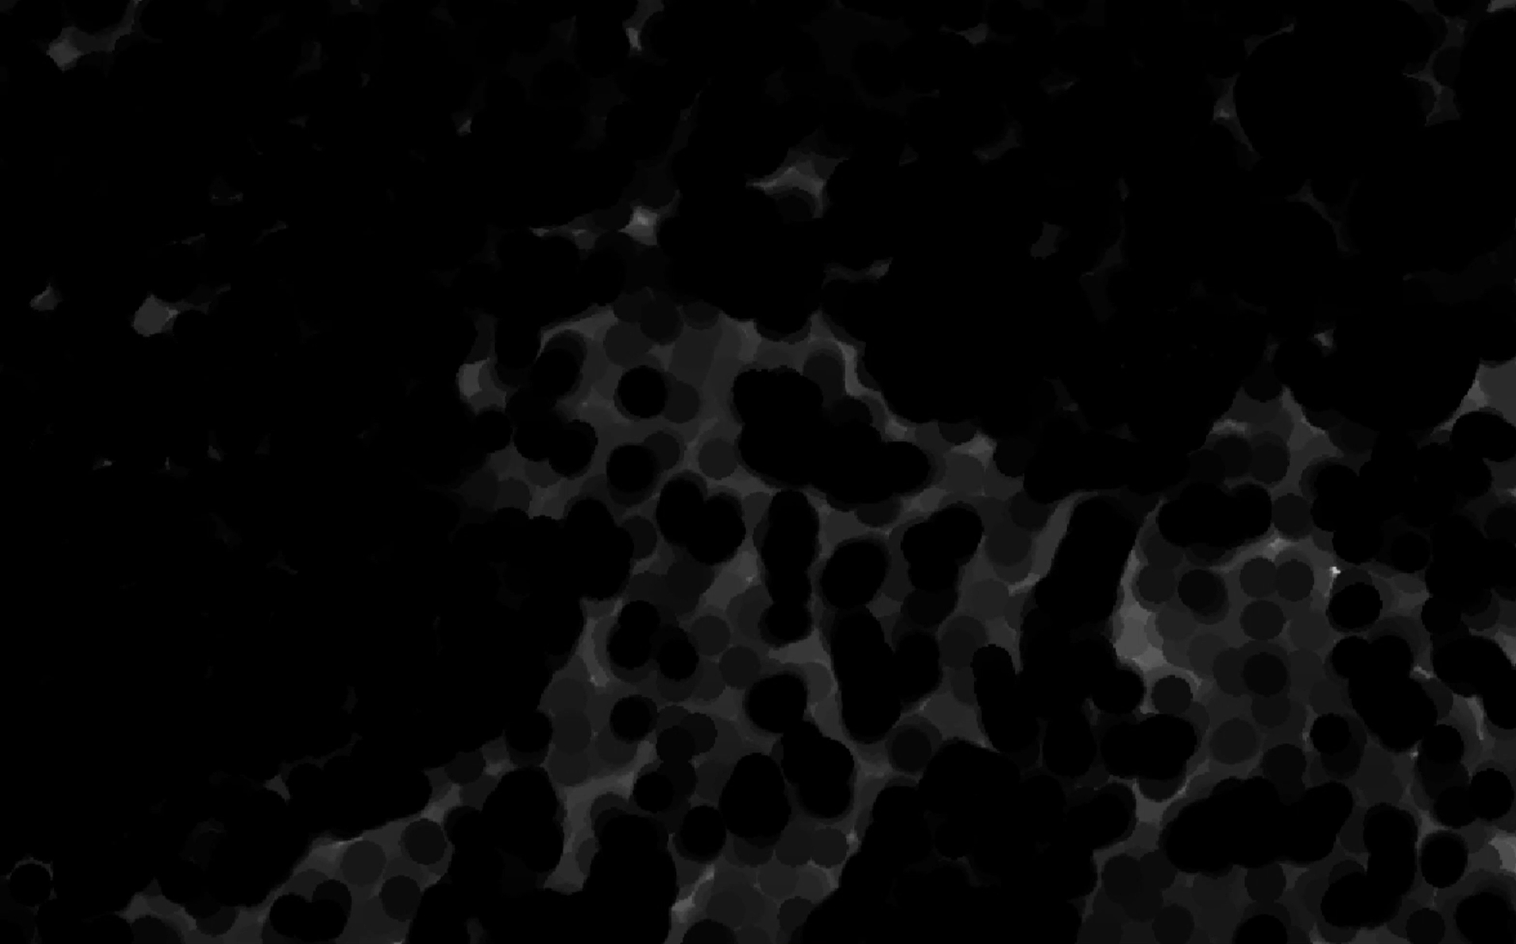
Original image
Has both nuclei and background
Background radius: 10
Has only left the background to be subtracted, nuclei are not there

Slide 6
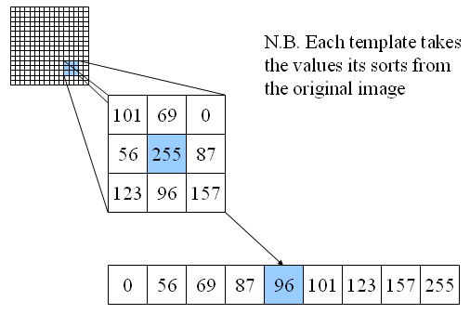
Median Filter:
Desc:
Removes noise by applying a simple median function, leading to smoothing. Takes the median of a pixel's neighboring pixels and sets it as the new pixel value.
Best value for my images: 1
Optimization range:
0 µm or 1 – 1.5 in 0.1 µm intervals.

Slide 7
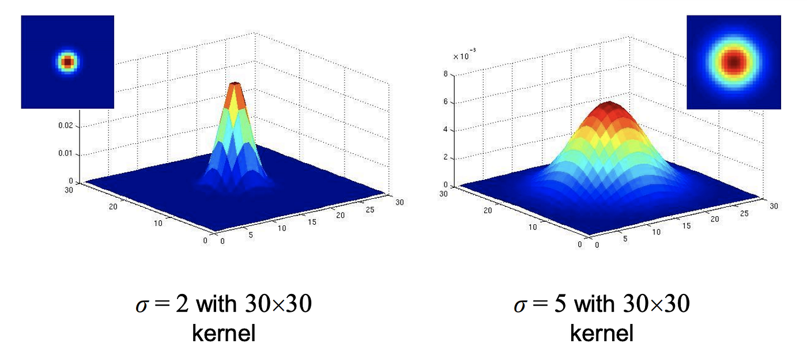
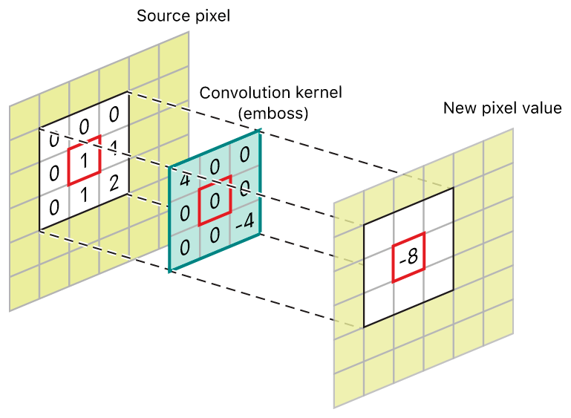
Sigma
Desc:
Removes noise by applying a gaussian normal distribution function, leading to smoothing.
Best value for my images: 1.2
Optimization range:
0.5– 1.5 in 0.1µm intervals.

Slide 8
Note: Smoothing filters (Median/Gaussian)
They are kinda the same, dont get confused
Same purpose, different methods

Slide 9
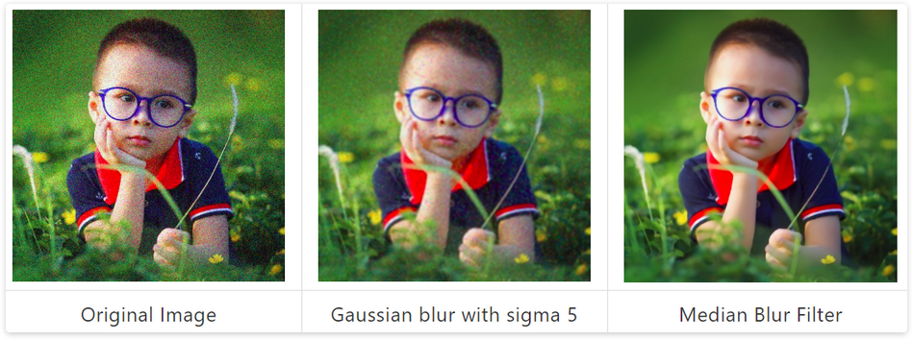
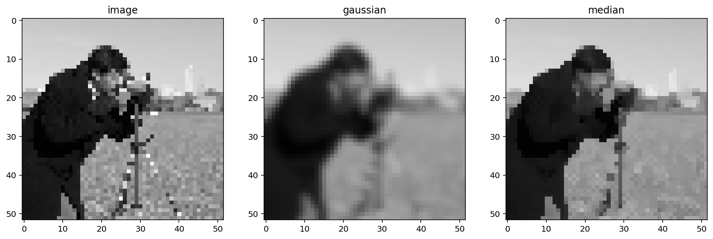
Original
Gaussian (sigma)
Median

Slide 10
Min Area
Desc:
Usually sufficient for most images and doesn’t need change. If small cells aren’t detected this value can be reduced and if small artifacts are detected it can be increased.
Best value for my images: 8
Optimization range:
0 µm or 8 – 50 in 5µm intervals.

Slide 11
Max Area
Desc:
Sets a limit for the max size of one cell.
when cells are bigger, increase amount
Best value for my images: 50
Optimization range:
0 µm or 8 – 80 in 5µm intervals.

Slide 12
Threshold
Desc:
min OD Haematoxylin.
Best value for my images: variable
(Depends heavily on staining vectors and the brightness/contrast of the image)
Optimization range:
0.05 - 5

Slide 13
Cell expansion
Desc:
How big the cells are
Best value for my images: 8
Optimization range:
2-10 in 1 µm intervals.

Slide 14
subcellular detection threshold
Desc:
OD of selected RNA/miRNA stain.
If you want to have classifications e.g.
1+ : 1-4 puncta in cell nucleus
2+: 4-10 puncta in cell nucleus
3+: 10+ puncta in cell nucleus
Then activate the “multi threshold” option
Best value for my images:
Variable between 0.2 and 1.5
Optimization range:
Depends on the staining vectors and the signal visibility, but moving up/down in 0.1 µm should help improve results.

Slide 15
Positive cell detection thresholds
Desc:
The OD value of the stain in the cell nucleus.
If you want to have classifications e.g.
1+ : weak signal
2+: medium signal strength
3+: high signal strength
Then activate the “multi threshold” option
Best value for my images:
Variable
Optimization range:
Depends heavily on the staining vectors and the signal visibility, but moving up/down in 0.1 µm intervals should help improve the results.

Slide 16
*Using saved images from ImageJ
From time to time, you will encounter images that need a little bit of color/brightness adjustment to work best with the cell counting plugin. A common way of fixing issues like this is using imageJ to apply these small edits and saving the images as the edited versions. A better way of doing this is using the NIS elements app, accessible through the computer in the microscopy room.
These saved images will not however keep their metadata, which contain essential parameters like µm per pixel. This then needs to be added in from the other images by hand in QuPath before running the cell detection plugin, otherwise the results will be invalid. This is also very much visible.
It would be preferred not to save edited images onto the original files and rather keep them as copies (duplicates). Use shift + D

Slide 17
*Using saved images from ImageJ
For fixing the metadata and the pixel values (height and width), either manually copy the values from non-corrupted images with similar magnification or use the fix_metadata script. If the magnification is not 400x, the values in the script need to be manually changed as well.

